Slide 1

DS Project:
ARCADE GAME SCORE TRACKING SYSTEM
Group Members:
2510030150 - Medavarapu Saathvik
2510030142 - Sankeerth
2510030211 - Praneeth
2510030288 - Harshit
Guided By:
Mahesh Babu Sir

Slide 2
Project Overview
Arcade game s
System to manage scores of multiple games and players
Uses core data structures: Arrays, Stack, Queue, Linked List
Supports input validation and structured storage

Slide 3
Working of the System
User enters number of games and players
Scores are stored using arrays
Sorting applied to rank players
Data structures used for different operations

Slide 4
Data Structures Used
Array → Store player scores
Stack → Undo operations
Queue → Process players sequentially
Linked List → Store high scores & results

Slide 5
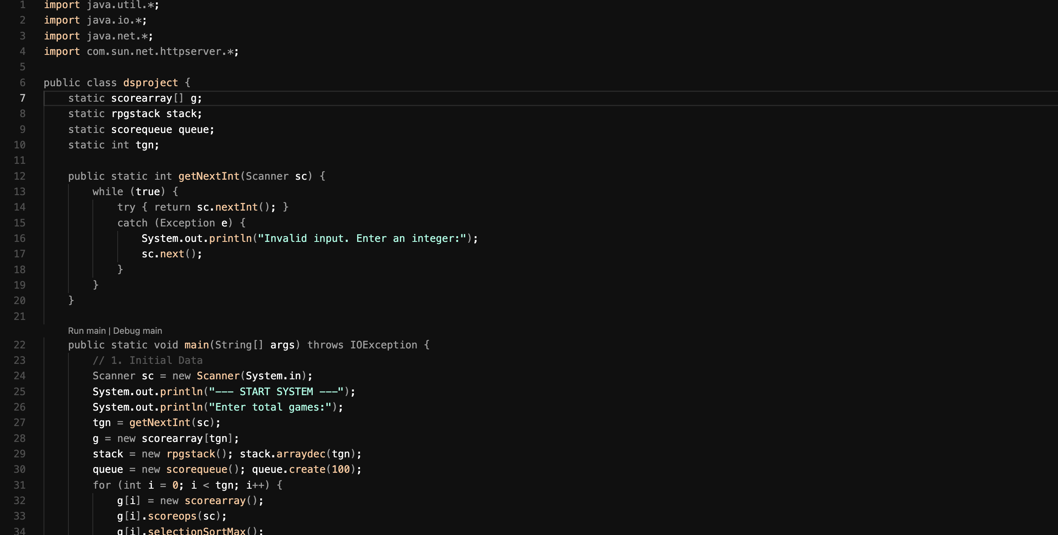
Main Class (Control Flow)
Handles user input and initialization
Validates input using getNextInt()
Creates all data structures
Controls execution flow, the exception s and file handling are also added for user convinience

Slide 6
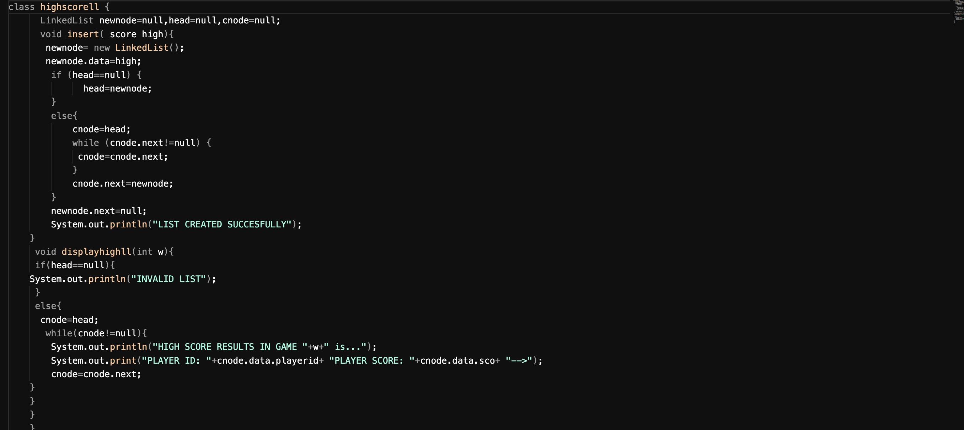
High Score Linked List
Stores high scores using linked list
Insertion at end of list
Traversal used for display
Efficient dynamic storage

Slide 7
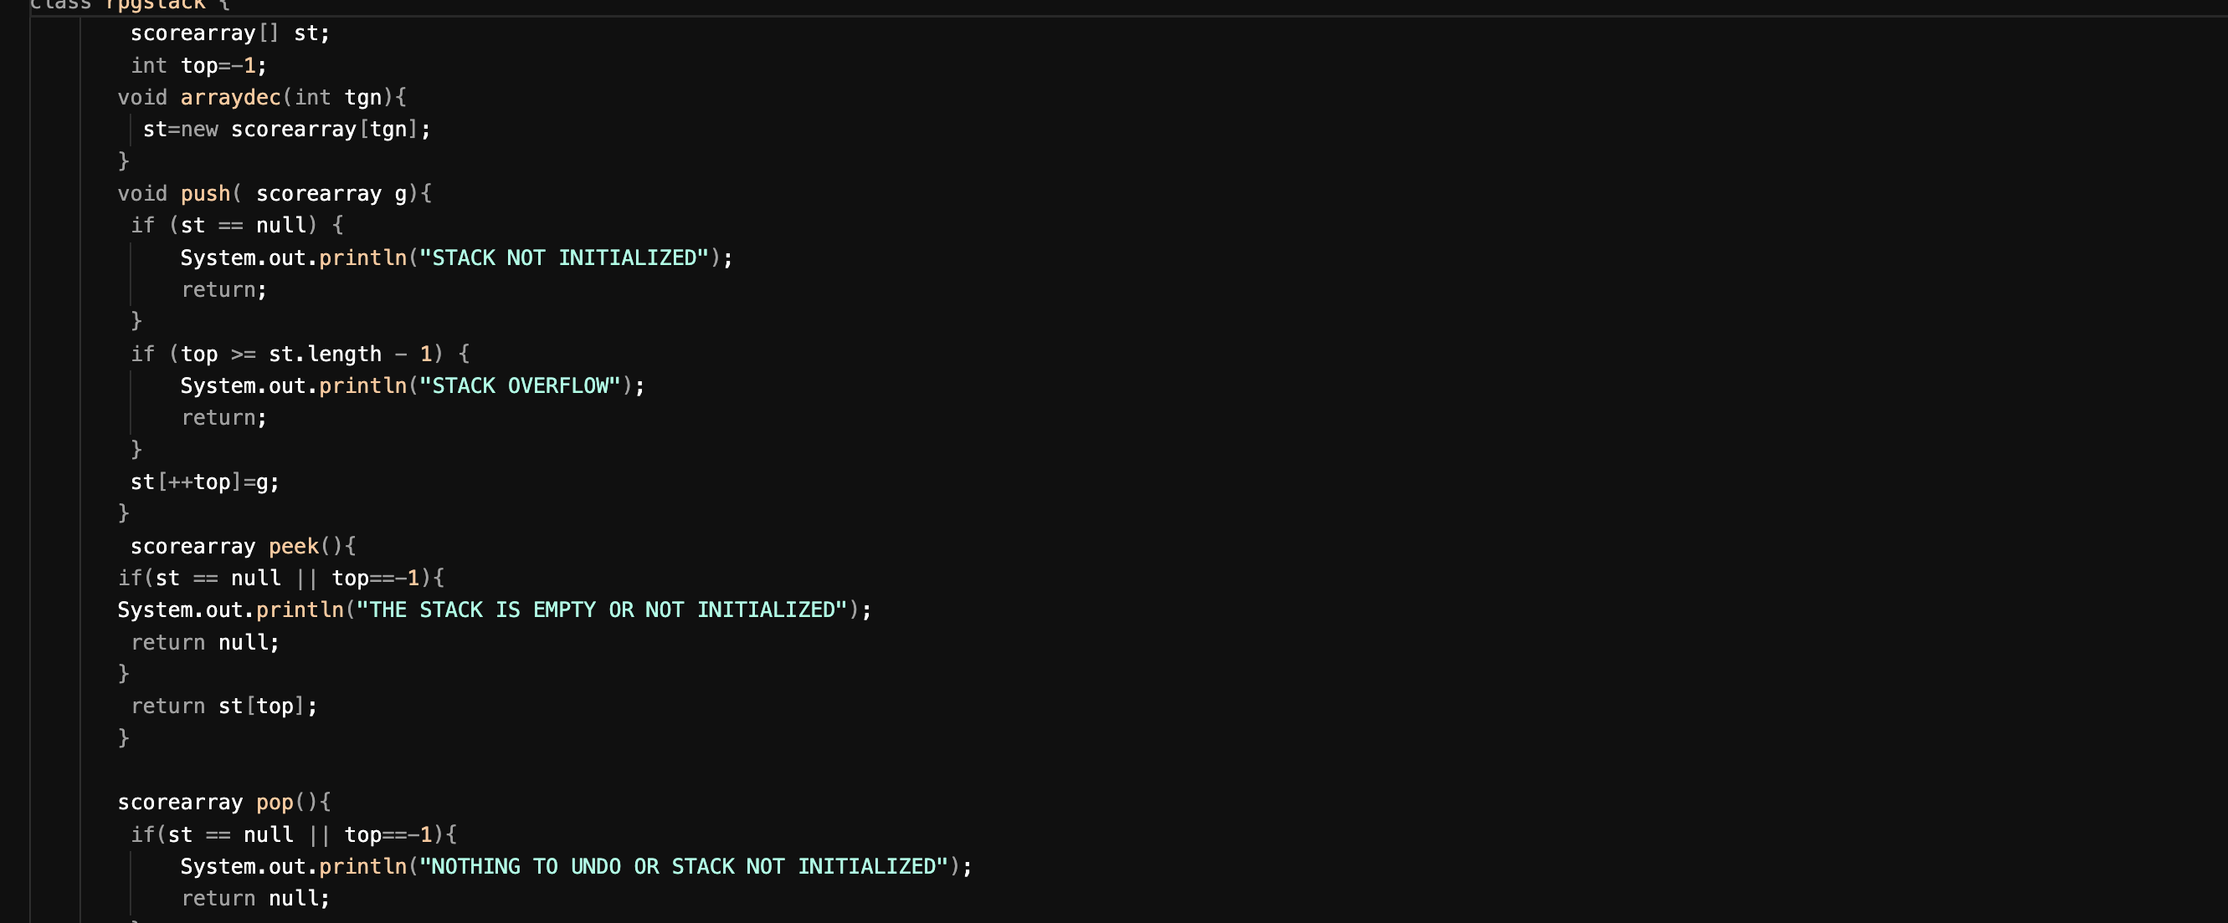
Stack Operations
Implements push, pop, and peek
Used for undo functionality
Array-based implementation
Handles overflow and underflow

Slide 8
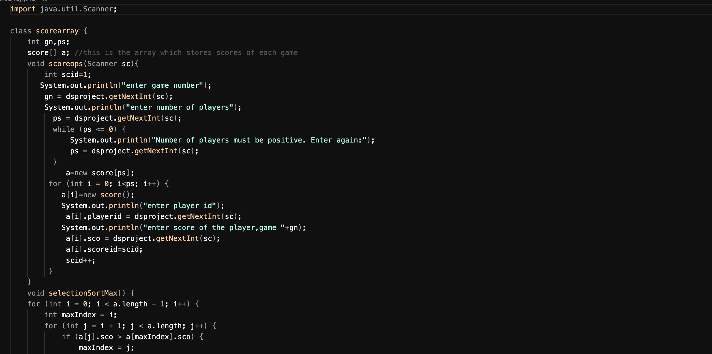
Score Array & Sorting
Stores player ID and scores
Selection sort used for ranking
Ensures highest score ordering
Core computation part of project

Slide 9
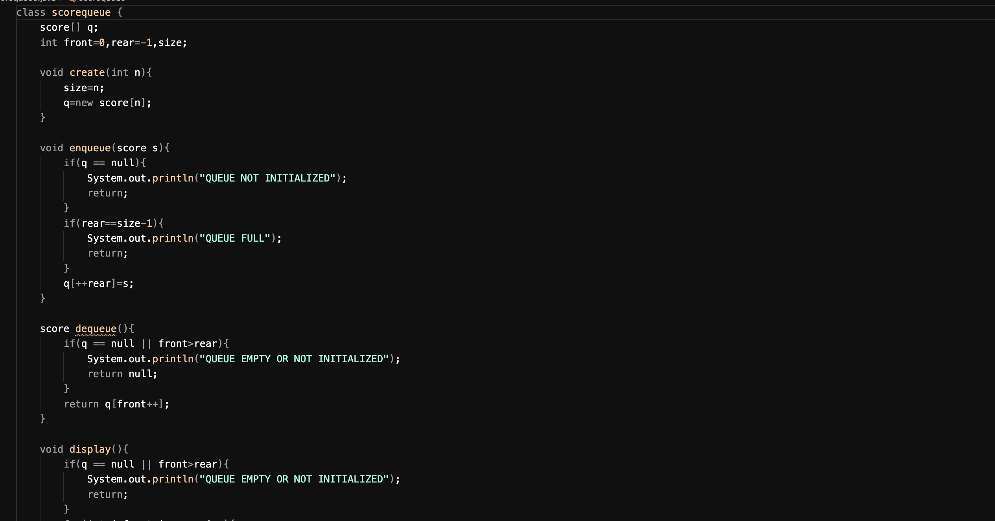
Queue Operations
Implements enqueue and dequeue
Processes players in order
Array-based queue
Handles full and empty conditions

Slide 10
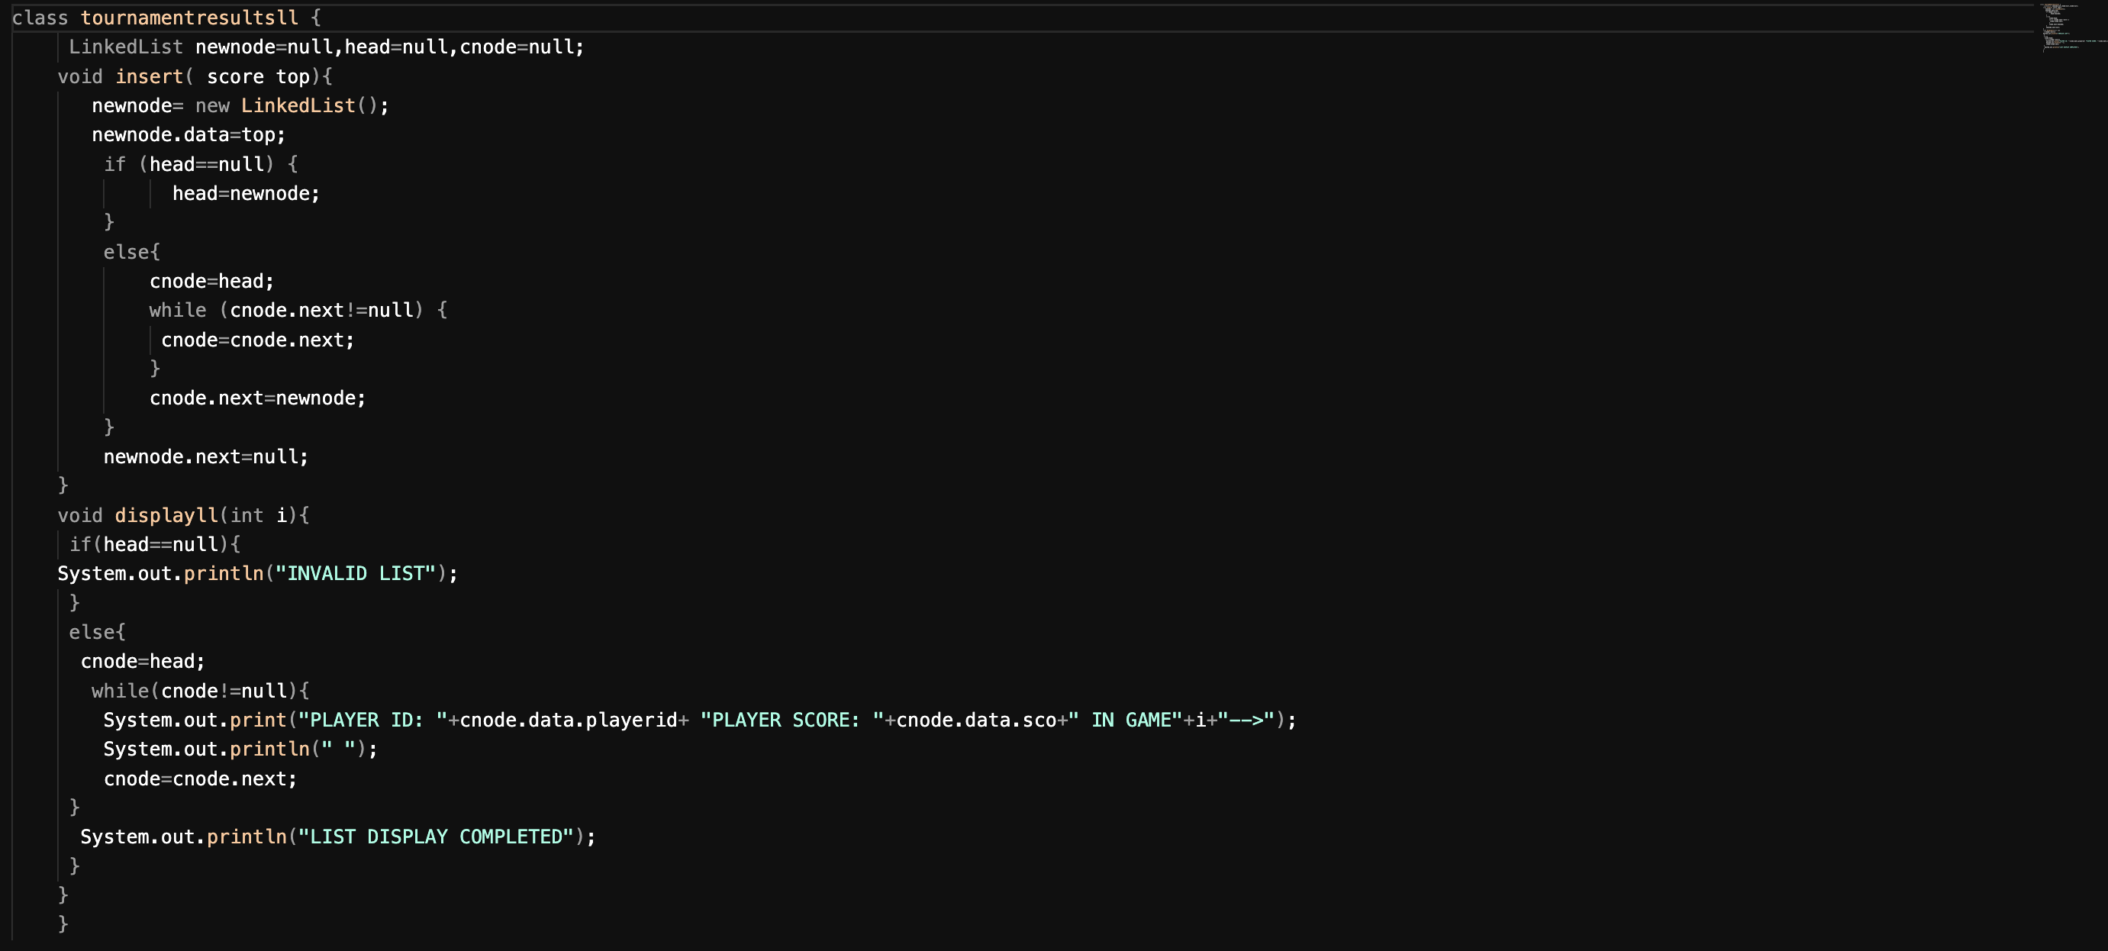
Tournament Results Linked List
Stores final sorted results
Displays player scores per game
Uses traversal for output
Final output representation
The html page is also added for every use and result is stored in separate file

